Slide 1
Remote Games

Slide 2
Basic Information
Selected Prompt: Netflix + Krill - A Squid Party Game
Collective Number and Member Names: 1105 / Cameron Henritzy, Charles Cenizal, Justin Juang, Bill Wong, Ryca Zhang

Slide 3
Game Design
Players will be invited via email
Since the whole theme of our games were meant to be played online we created games that were easy to play on the spot or games that were convenient to play.
We also created these games with the mindset of elimination all the way to 2 people
We based this whole process around Squid Game itself and battle royale aspect of it by having these elimination games leading up until the final 2 games where there will be one chosen winner

Slide 4


Slide 5
Meta-Rules
The entire competition works to where there will be 50+ players leading up to the point where there will be 2 players at the end of the final game.
Players will be eliminated if they do not satisfy the game’s conditions and to ensure that there will be 2 players in the final round we designed games to force the right amount eliminations
Rewards will be bragging rights and winner of the whole competition will feel a sense of achievement by being the best player among 50+ people
How people will be able to opt out of the competition will be through a voting system
Those that voted yes will be opted out of the competition while those that voted no will remain within the competition. If the remaining player count is lower than 50 then the games will not continue

Slide 6
Games
Beach Marbles
Tracer
Color Switches
Circle Crossing
Theme Parks
War and dice

Slide 7
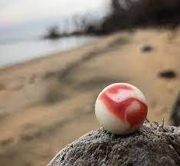
Beach Marbles
Two teams stand on opposite sides of a large rectangle with a circle in the middle. One team uses blue beach balls. The other team uses red beach balls. The goal is to get as many of "said color" beach balls in the middle circle by throwing them. and trying to knock out the enemy teams marbles while you are at it

Slide 8
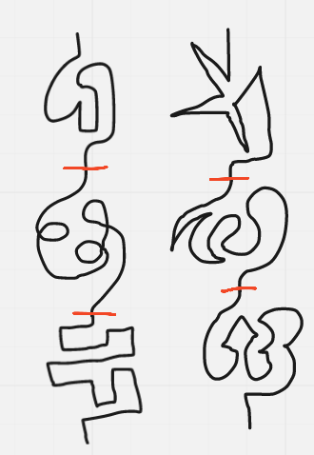
Tracer
Each player will receive a line obstacle at random. The goal of this game is to be able to trace the line all the way towards the end. If players stray off the line or fail to trace the line under the given amount of time, they will be disqualified and end up being eliminated.

Slide 9
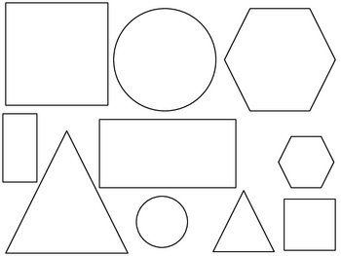
Color Switches
Each player will be given a random shape. The goal will be to fill in the shape with any color under a specific amount of time. If the player fills anywhere else outside of the shape it will result in a penalty of elimination. The given time for this game will be 1:30

Slide 10
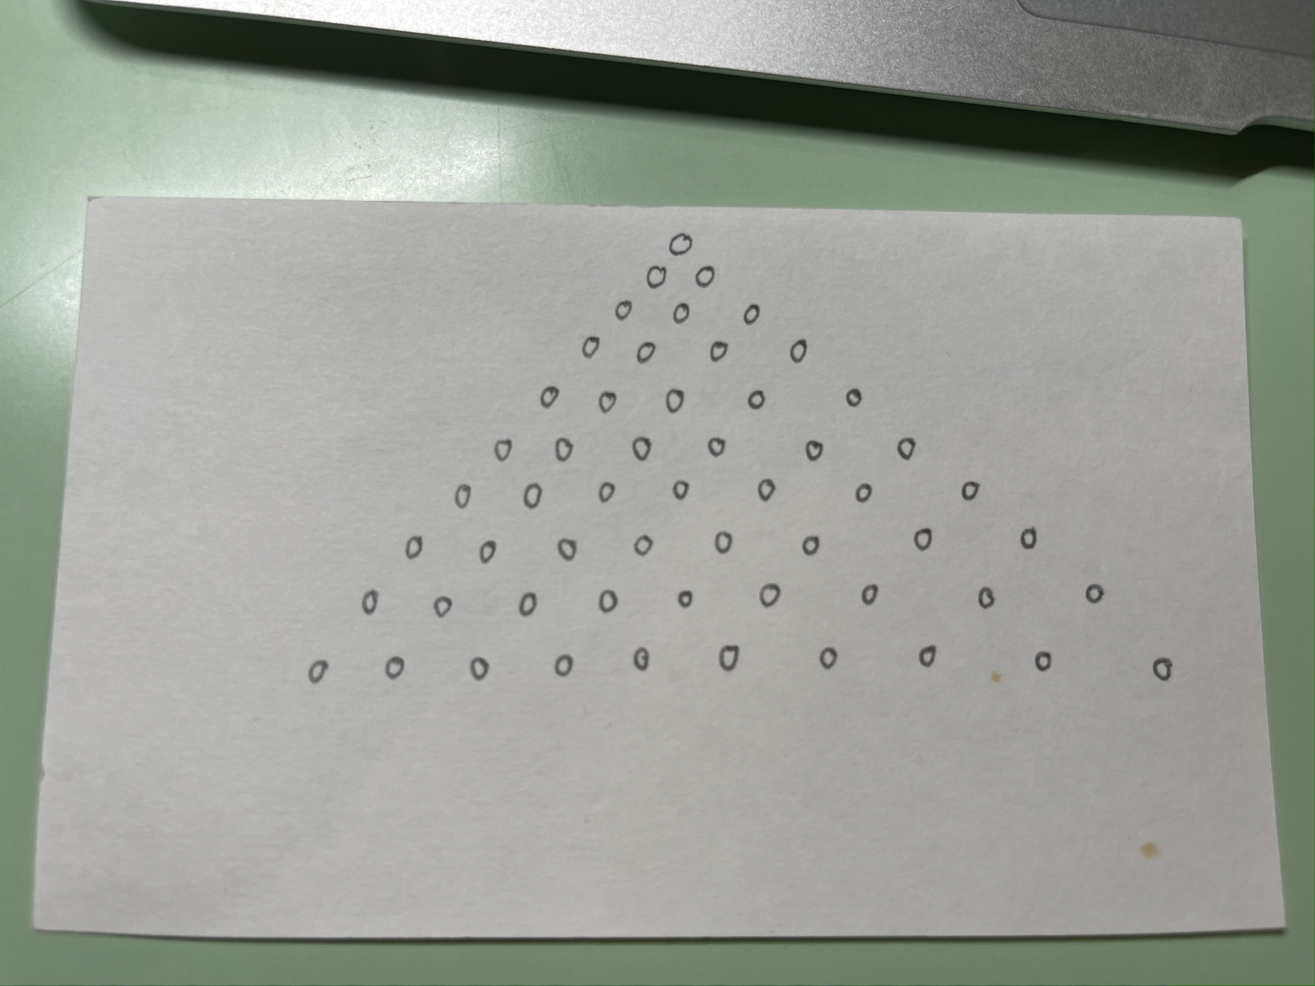
Circle Crossing
1v1 game, half of the people will be eliminate
A game similar to tic-tac-toe, but with the game set up like the image. Player can only cross out at most three circles, at least one circle each round. The cross must be in a straight line.
Who ever cross out the last circle wins the game
Played three round to determine the winner; loser of each round can choose who to start the next game

Slide 11
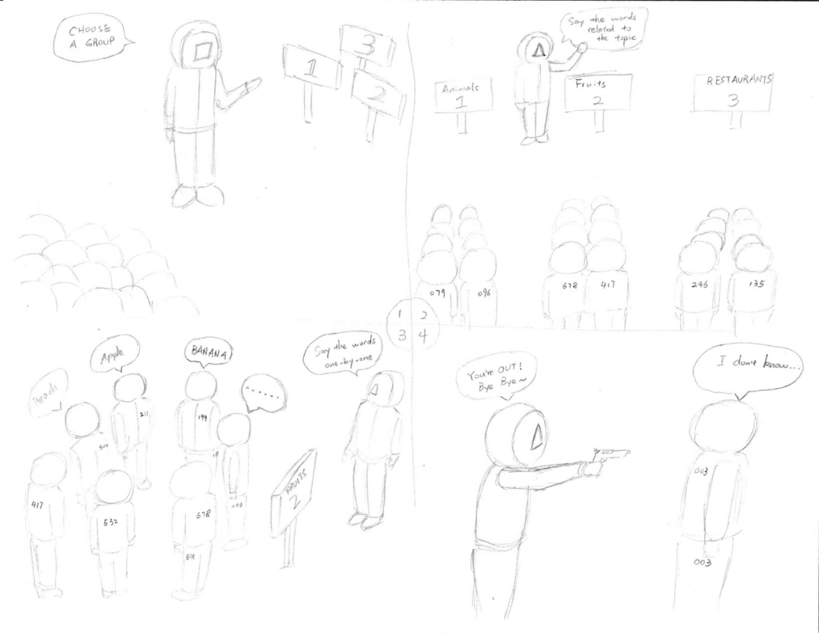
Theme Parks
Divide the remaining people into three groups (zoom: breakout rooms)
The moderator sets three different themes for the three groups
In the order from top to bottom (front to behind), each person should immediately give a word related to the theme of this group.
The person who failed to give the word immediately, or gives a repeated or wrong word will be out.
The moderator will change the group theme when a person is out.

Slide 12
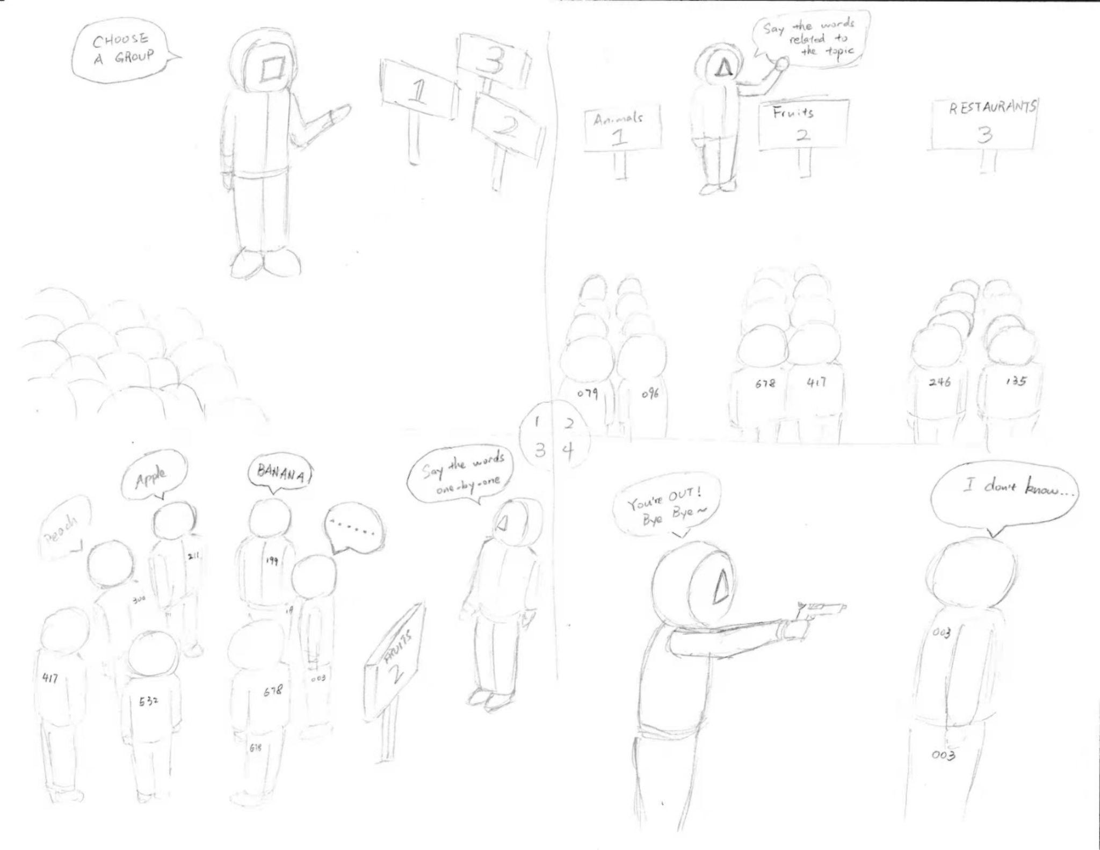

Slide 13
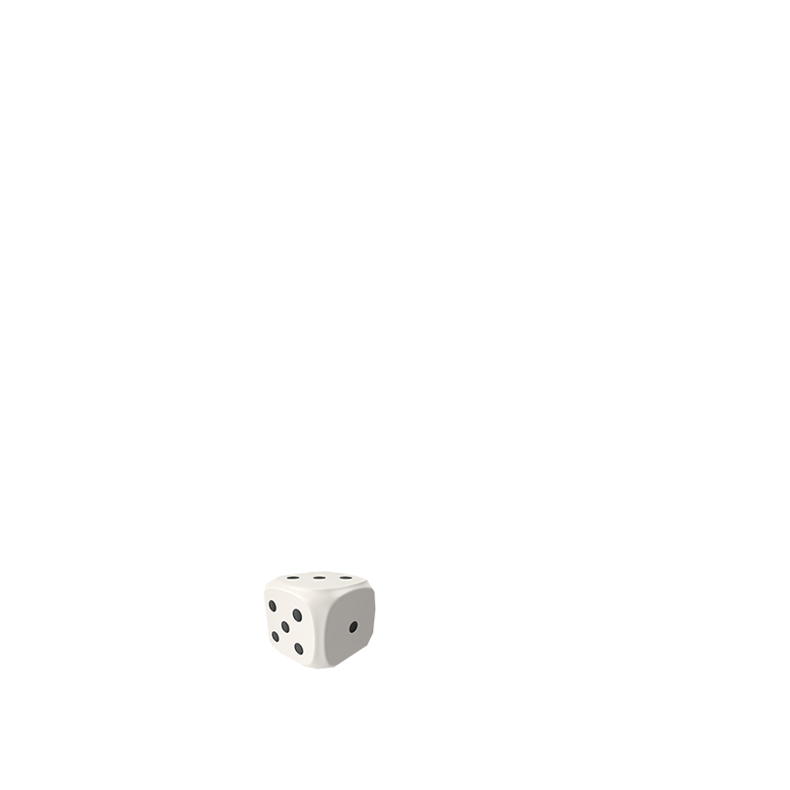
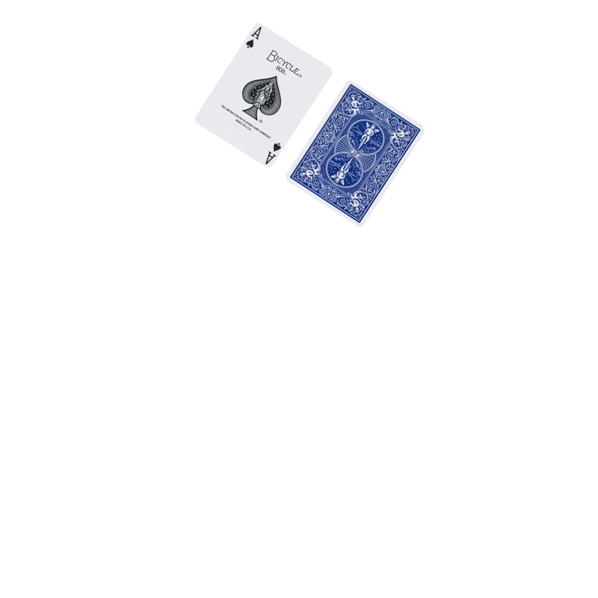
War and Dice
This game is played 1 vs 1. Using a standard deck of Poker Playing Cards, each player will pick one unique suit, and take out the numbers 2-10 corresponding with that suit. Then each player will receive three 6 sided dice. (ex: Player 1 picks 2-10 of Hearts, and 3 dice. Player 2 picks 2-10 of Spades and 3 dice.)
The goal of the game is to win either all your opponents dice, or win all your opponent’s cards.
The game is played in rounds. Each round one player sets the top card of their deck face-down, and they can look at their card, then decides if they want to roll a die. The die roll result will be subtracted from the opponent’s card value, but if the result would be negative, it will be added instead. In the end of the round, the player with the highest card value will win the round, and take the cards used as well as win any dice used that round. However, the cards and dice won in a round cannot be used again, and are placed in a face-up pile layed out side-by-side so both players can see how many cards have been won by each other.
If a player’s cards have all been used, then they lose one die, their cards are reshuffled, and the rounds continue.

